Slide 1





M&A INTEGRATION MANAGEMENT OFFICE
KICKOFF MEETING

Slide 2
Topic
Objective
Kickoff
Meeting
Agenda
Value Drivers
Discuss key value drivers of the deal
Integration Guiding Principles
Discuss guiding principles
Integration Governance Structure
Review governance framework, roles and responsibilities and meeting cadence
Integration Timeline
Current planning timeline and milestones
Tools
Planning and collaboration tools
Rules of Engagement
Review regulatory requirements prior to close
Next Steps
Review the next steps for workstream teams
© 100-Day Advisors MandAPlaybook.com

Slide 3
Value Drivers
Value Driver
Acquisition Objectives
Measures
Employee Engagement
Ensure the combined organization reﬂects our core values
Develop, deliver and sustain an enhanced employee experience across the combined organization
Employee satisfaction measures
Employee culture embedded across the organization
Employee retention
Employee feedback actioned as appropriate
Customer satisfaction
Deliver a best-in-class customer service experience across all locations and services
Best-in-class customer satisfaction scores for each division/service/location
Realize identiﬁed costs and revenue synergies
Sales/marketing and business unit workstreams to identify and realize cross-selling and new customer acquisition opportunities
Shared service teams and other teams should identify and realize potential cost optimization opportunities across stafﬁng, facilities, IT, vendors and other areas.
To be determined based upon identiﬁed cross-selling and upselling opportunities
To be determined based upon identiﬁed cost synergies
© 100-Day Advisors MandAPlaybook.com

Slide 4
Integration
Guiding Principles
What
Why
How
The principles the integration teams will follow to guide their attitudes and behaviors while working together to develop the integration plans
Distinct from, but inﬂuence integration planning assumptions, integration strategy, and integration objectives
Provide a foundation for rapid and effective decision-making
Ensure personal interests and agendas are set aside in favor of decisions that ensure a seamless customer experience and successful transition
Ensure that people on the integration teams feel empowered to make decisions quickly
Honor the pride and dignity of people and organizational legacies
Involve the key stakeholders
Begin with the investment thesis for the transaction
Consider the objectives and value drivers of the integration
Filter through the organization’s Vision, Mission, and Values
Pick a starting point and revise to consensus
© 100-Day Advisors MandAPlaybook.com

Slide 5
Our Guiding Principles
1.
Prioritize the key
value drivers:
2.
Integrate rapidly, but not recklessly
4.
Treat people fairly, respectfully and over-communicate
Combining our collective capabilities to create the preeminent global business administration and compliance solution for our customers
Customer satisfaction
Employee Engagement
Realizing the identiﬁed revenue and cost synergies
We should share and consider ideas and alternative points-of-view; but recognize we must determine the best course of action and pursue it expeditiously
3.
Never ever compromise culture and compliance
5.
Integrate without disrupting day-to-day
operations
© 100-Day Advisors MandAPlaybook.com

Slide 6
Integration
Governance Structure
STEERING COMMINTTEE
INTEGRATION MANAGEMENT OFFICE (IMO)
Coordinates teams, sets pace, prioritizes work, brings methodology, and manages interdependencies
Senior leadership approves plans and provides guidance
Acquirer Representatives
Acquiree Representatives
Acquirer Integration Sponsor - Bart Davis Acquirer & Acquiree Program Managers – Sunny Chap, Dan Viola Comms & Change Management – Kate Matthews, Linda Fort
BU 1 | BU 2 | BU 3 | Comms | Finance | Human Resources | Sales & Marketing | Information Technology | Legal | Facilities
Lead all integration planning and execution activities for functional areas
Ensure completion and adherence to the scope identiﬁed for workstream area(s) in charters
Manage all assigned initiatives
Keep integration plans updated and track issues
Establish any sub-teams required for workstream completion
Work with other team resources to determine interdependencies
Adhere to pre-close rules of engagement
© 100-Day Advisors MandAPlaybook.com

Slide 7
Meeting Cadence
MONDAY
TUESDAY
WEDNESDAY
THURSDAY
FRIDAY
SALES &
MARKETING
FACILITIES
BU 1
IT
COMMUNICATIONS
HR
LEGAL
BU 2
WORKSTREAM PRIMARY LEADS MTG
FINANCE
SMARTSHEET UPDATES DUE
STEERCO MEETING
Status updates and guidance on the integration
Monthly or Ad-hoc
WORKSTREAM PRIMARY
LEADS MEETING
Cover items that are relevant for all workstreams, e.g., project management related, Stereo decisions, etc.
Weekly
WORKSTREAM 1-ON-1S
MEETING
Go in-depth on integration tasks, issues, risks,
dependencies, decisions needed
Day & Frequency TBD
SMARTSHEET
UPDATES DUE
Smartsheet work plan updates due every Friday. The inputs are used to develop reporting for following week
Day TBD
© 100-Day Advisors MandAPlaybook.com

Slide 8

Integration Timeline
Value Identification & Definition
Value Capture
January
February
March
April
May & Beyond
Define integration governance
Perform integration diligence
Determine guiding principles
Define/Address strategic integration decisions
Deliver M&A Training
Conduct IMO kickoff meeting
Start to make integration decisions / understand assumptions
Continue integration diligence
Identify quick wins
Prepare high-level Day 1, First 30 days, and end of year work stream plans
Begin high-level integration work stream plans for end state
Prepare detailed Day 1, First 30 days, and end of year plans (includes communications, staffing, and risk management plans)
Execute Day 1 and First 30 days plans
Execute end of year and beyond work plans
Lock in Plan of Record for end state
Day 1
© 100-Day Advisors MandAPlaybook.com

Slide 9

Integration Planning
Milestones
Charter Development
Work Plan Development
3/1
Today
1/1
5/1
Executive Kick Off
Workstream kick Off
Walk-the-wall
Close
Socialize governance, guiding principles, etc. with Workstream Leads
Review workstream plans and validate Interdependencies with workstream leads
© 100-Day Advisors MandAPlaybook.com

Slide 10
Tools
Smartsheet – planning, execution and reporting on the integration
SharePoint– document collaboration, meeting slides and notes
© 100-Day Advisors MandAPlaybook.com

Slide 11
Rules of Engagement ¹
Until the proposed transaction with Acquiree has closed, there are certain regulatory requirements that restrict what can and cannot be done regarding customers, commercial partners and employees. It is essential that all Acquirer and Acquiree personnel strictly adhere to the following guidelines, unless permitted by counsel:
Do remember that Acquirer and Acquiree are independent companies until the transaction is completed, i.e., until the deal is closed.
Do reassure customers and/or commercial partners, as applicable, that in the interim and until the transaction closes, it will be business as usual.
Do continue to compete aggressively for new business and to retain existing customers and commercial partners.
Do indicate that until all regulatory reviews are complete and the deal closes, each company is required to maintain its separate identity, separate operations and separate personnel.
Do indicate that the companies will be working together on integration planning to make the post-closing impact on customers and commercial partners as seamless as possible.
© 100-Day Advisors MandAPlaybook.com

Slide 12
Rules of Engagement ²
Don’t hold yourself out as a spokesperson for Acquiree services or refer existing or potential Acquirer customers or partners to Acquiree’s salesforce or business development team (or vice versa).
Don’t make joint sales or marketing calls with Acquiree or in any way coordinate with Acquiree for new or existing business or hold Acquiree out as part of Acquirer.
Don’t make representations to customers or commercial partners about the likely impact of the proposed acquisition on existing or future services (e.g., current corporate client services, new service offerings / jurisdictions, etc.) beyond what has been communicated publicly or otherwise authorized by Acquirer.
Don’t speculate as to the future plans, strategies, strengths, weaknesses, opportunities or threats with respect to the combined entity and do not write any documents, including emails, discussing any of these topics unless authorized in advance by the Legal Department and as part of the integration planning process.
Don’t reach out to your counterpart(s) at Acquiree to request or share information outside of approved integration channels.
Be aware that U.S. and other antitrust and competition laws severely restrict what can and cannot be said to customers and what can and cannot be done jointly with Acquiree prior to closing. If you have questions or are unsure what you can and cannot say or do, ask before you take such action. Missteps with customers, commercial partners or Acquiree during the regulatory review process could jeopardize the timing of clearance and delay implementation of the transaction.
© 100-Day Advisors MandAPlaybook.com

Slide 13




Next Steps for
Each Workstream
Team Kickoffs held
Workstream charters developed
Charters translated into high-level plans
© 100-Day Advisors MandAPlaybook.com

Slide 14
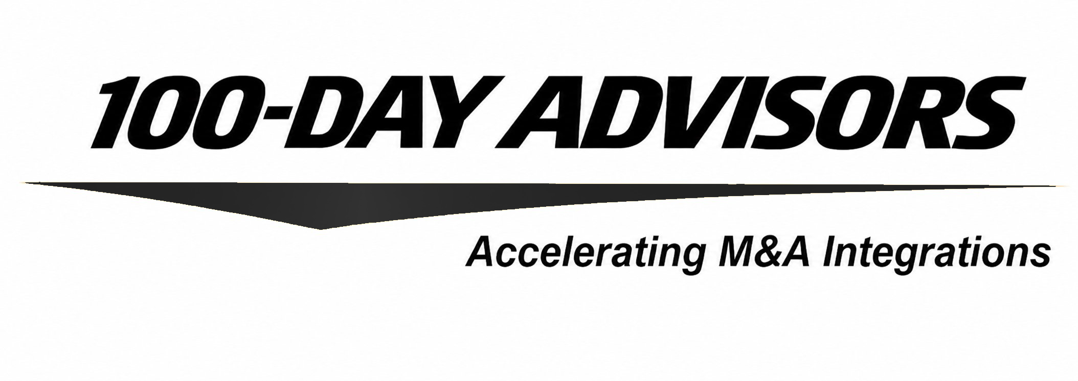
contact us
email
inquiries@MandAPlaybook.com
website
MandAPlaybook.com

